Slide 1

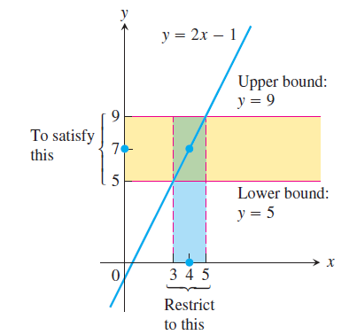
Section 2.3 The Precise Definition of a Limit
We now turn our attention to the precise definition of a limit. We replace vague phrases like “gets arbitrarily close to” in the informal definition with specific conditions that can be applied to any particular example.

Slide 2
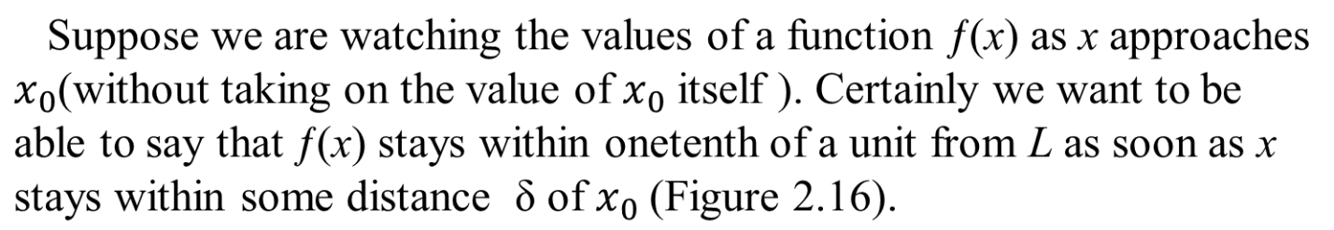
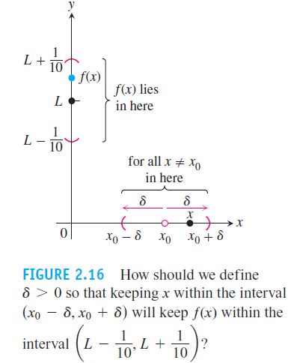

Slide 3
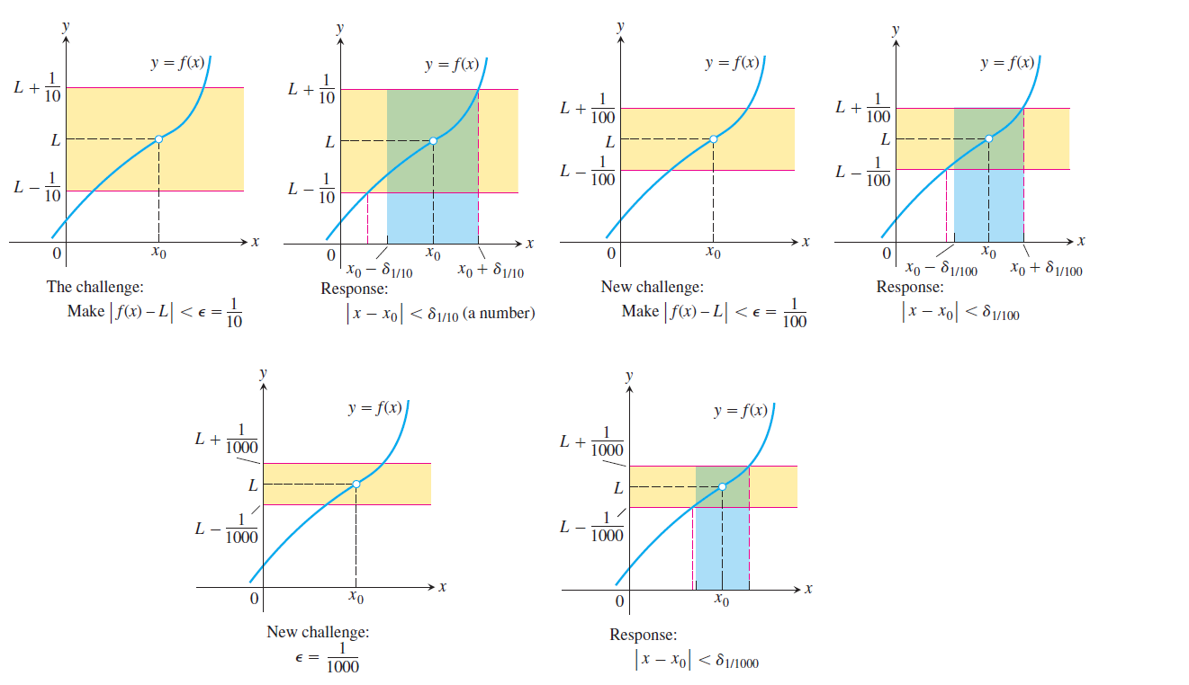
We can be told that the error can be no more than 1/100, or 1/1000, or 1/100000. Each time, we find a new about so that keeping x within that interval satisfies the new error tolerance. And each time the possibility exists that ƒ(x) jitters away from L at some stage.

Slide 4
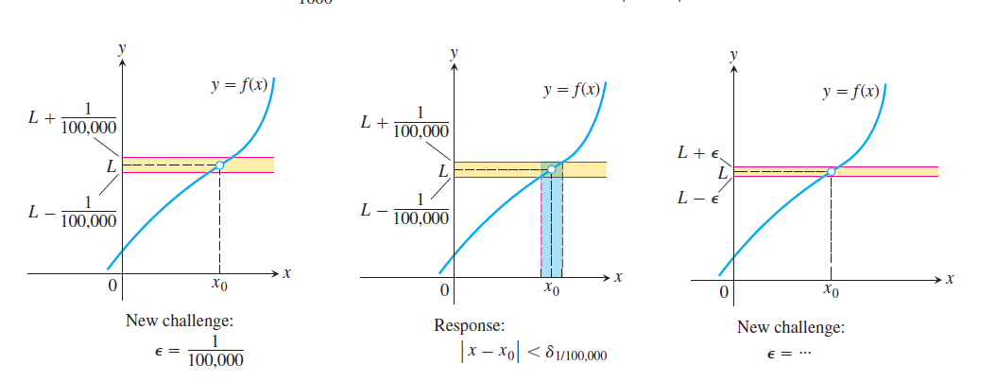
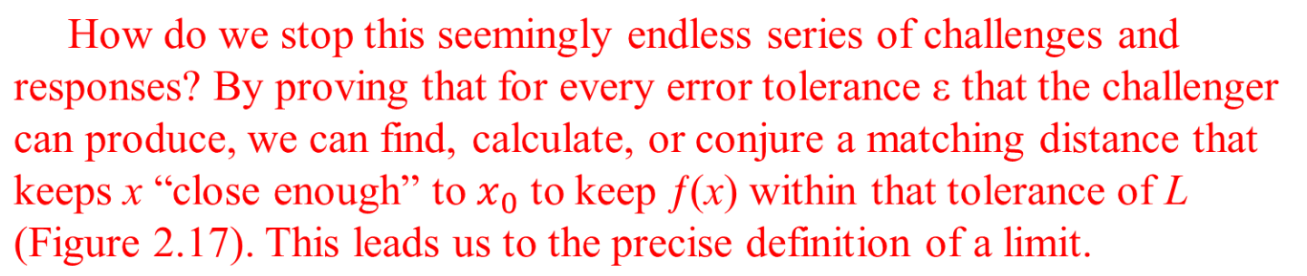

Slide 5
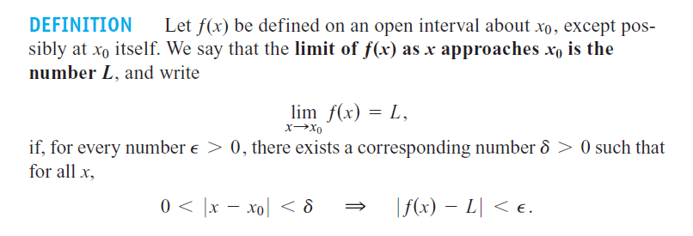
The formal definition of limit does not tell how to find the limit of a function, but it enables us to verify that a suspected limit is correct.

Slide 6
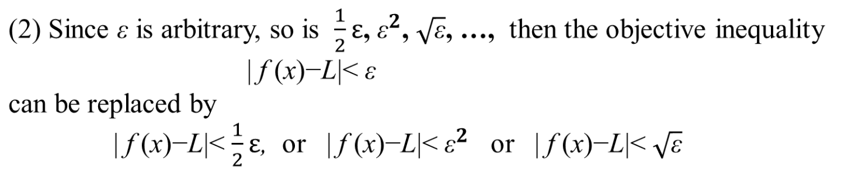
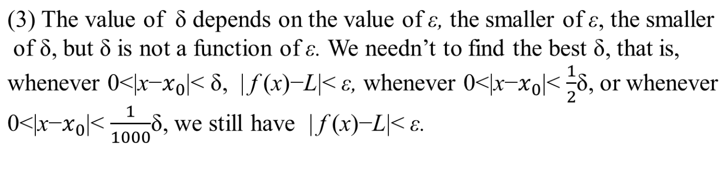
Remarks: (1) The smaller of ε, the closer of f (x) to L, therefore, we can restrict ε to 0<ε<1, 0<ε<0.5, …, but we can’t restrict ε to ε >1, ε >0.001,..

Slide 7
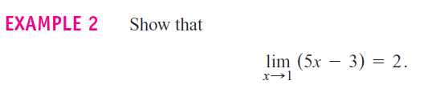
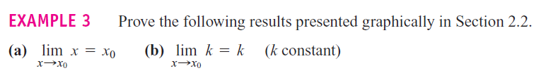
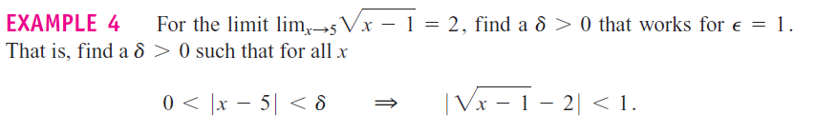

Slide 8
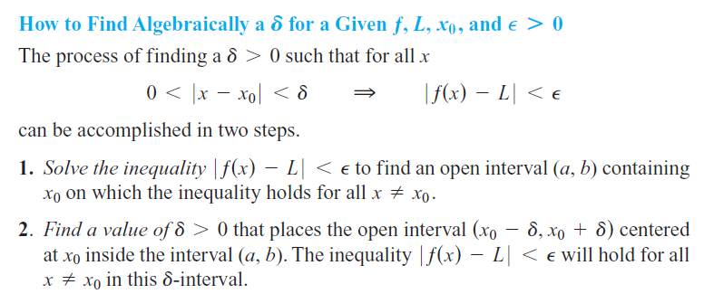
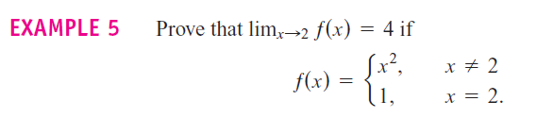

Slide 9
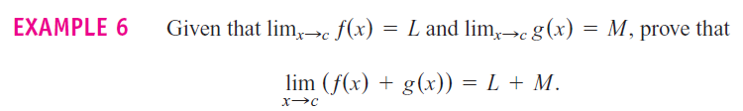

Slide 10
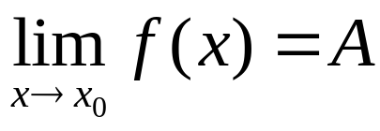
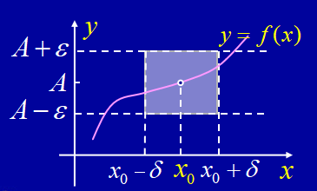
Geometric interpretation:

Slide 11
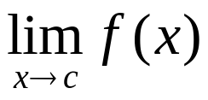
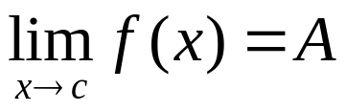


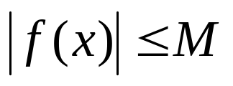
Properties of limit:
1. If the limit exists, then the limit is unique.
2. If the limit exists, then f(x) is locally
bounded. That is, when , then there exists M>0 and such that when ,

Slide 12
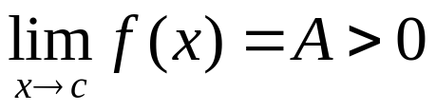
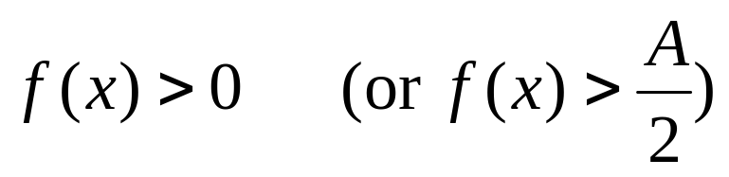
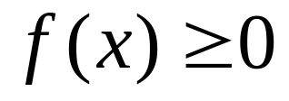
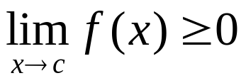
3. If the limit , then there exists
such that when ,
Corollary: If on a neighborhood of c except possible
at c, , and the limit exists, then

Slide 13
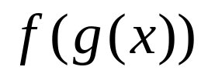
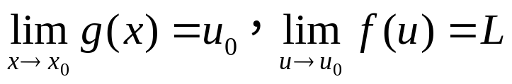
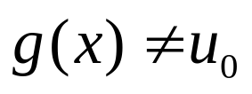
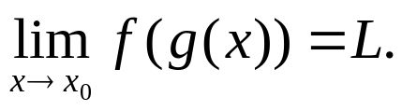
4. The composite function is defined on a neighborhood of x₀ except possibly at x₀ , if
and when x near x₀ , then
Remark: The condition: when x near x₀ is necessary, otherwise, the above result is false.

Slide 14
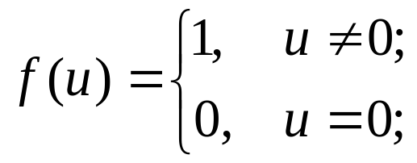
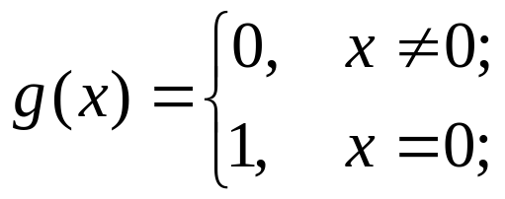
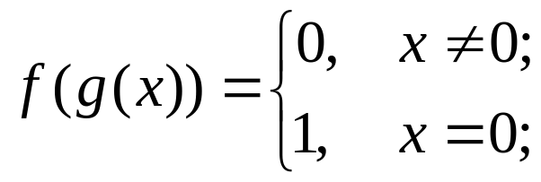
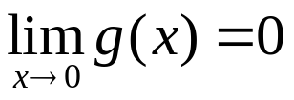

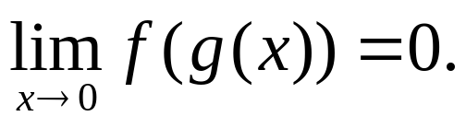
Example: If , then
and , , but

Slide 15
Homework: Page 83: 35, 40, 52, 53

